Slide 1



Go Faster Sooner! Discover SQL Server Index Improvements with the Biggest Gain for the Least Pain
SQLSaturday #1086
October 5th, 2024
Bill Sanscrainte Bill@Sanscrainte.com
Get this presentation, Excel spreadsheet, & T-SQL code at
https://github.com/SQLXL/SQLXL
Notes:
*00:00*

Slide 2

Microservice design review

Slide 3

That moment before committing changes to production

Slide 4

Explaining synchronous replication

Slide 5












Please Thank Our Sponsors!

Slide 6
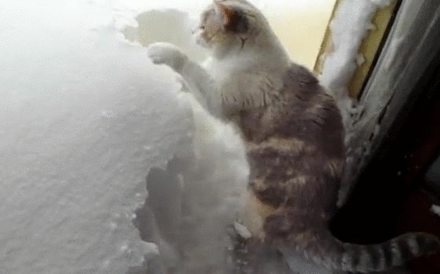
Heaps in real life

Slide 7

Hi Ho, Hi Ho, it’s off to work we go

Slide 8

Finding the missing comma

Slide 9

Session Evaluation Win 6x$50 gift card
Event Evaluation Win $100 gift card

Slide 10

Junior DBA Recruiting video

Slide 11

Your fix makes you the new owner of performance issues

Slide 12


Connect, share, & learn with peers and thought leaders while celebrating all things data for a week of learning and networking opportunities.
November 4th Through November 8th in Seattle, WA
https://passdatacommunitysummit.com/

Slide 13

The meeting is finally over

Slide 14

Lift & shift to the cloud

Slide 15
Why are we here?
“Poorly designed indexes and a lack of indexes are primary sources of database application
bottlenecks”
learn.microsoft.com 07/26/2024

Slide 16

Developer learns what separates them from DBAs

Slide 17

Data Architect meets the NoSQL Horde

Slide 18

2nd level insists restarting SQL Server will fix it

Slide 19
Session Synopsis - 1
There are 1000’s of SQL community scripts to make indexes better.
But who has time to find and run a thousand scripts?

Slide 20

New covering index makes the app perform

Slide 21

Committing the fix

Slide 22
Session Synopsis - 2
What if … there was a tool that could:
- Find SQL Server index “hurts”
- Prioritize by table
- Prescribe pain reduction actions
- Share hundreds of diagnostics
- And present it all in Excel?

Slide 23
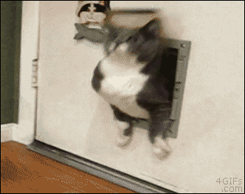
Restoring a copy of Prod to my laptop

Slide 24

Scheduling Ola Hallengren’s Maintenance Solution

Slide 25

Development agrees to document code changes

Slide 26
Session Synopsis - 3
Introducing SQLXL_Index!
Makes index tuning simpler

Slide 27
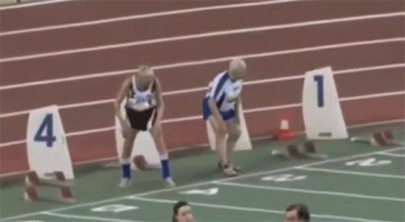
The CFO “suggests” getting another year from your servers

Slide 28

Accountants close the books on old hardware

Slide 29

Testing new hardware

Slide 30

Special thanks to these and other SQL community contributors!
Brent Ozar Kevin Kline Jes Borland Tom Collins Erik Darling Glenn Berry Gail Shaw Pedro Lopes Dave Bland | Tim Ford Sean McCown Kendra Little Pinal Dave Phil Factor Kalen Delaney Jason Strate Jared Westover Percy Reyes | Grant Fritchey Andy Yun Paul Randall Kimberly Tripp Edward Pollack Ahmad Yaseen Evgeniy Gribkov Ola Hallengren Denny Cherry | Aaron Bertrand Jonathan Kehayias Dmitri Korotkevitch Niko Neugebauer Monica Rathbun Kendall vanDyke Thomas LaRock Torsten Strauß Rebecca Hirschfield
Notes:
Shout out to these and others whose community contributions went into this presentation
Future Adds:
Jared Westover
Pedro Lopes (MS)

Slide 31
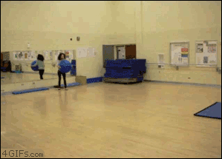
Merge replication conflict handling

Slide 32

First time hearing business requirements

Slide 33
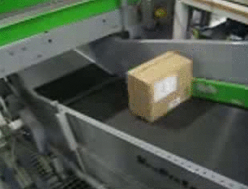
Developer forgets to mark queued records “complete”

